Slide 1
Perioperative THR Management
Nikolaos D. Konstantinou MD Orthopaedic Surgeon
Director
Orthopaedic Sports Injuries Clinic

Slide 2
Patient Management
Preoperative Patient Status Assessment
Intraoperative Patient Handling
Postoperative Care
Discharge permitting conditions
Follow-up visit

Slide 3
Preoperative Patient Informing
Indications for specific operation
Explaining the Goals and Dangers of the operation
Discussing Implant selection and fixation method
Obtaining Written Consent In specific form

Slide 4


Slide 5
Preoperative Patient Status Assessment
Mental Status
Religious Issues
Heart condition
Renal function
Current Medication
Anticoagulant Drugs
Cortisone or Biological Factors (antiTNF etc)
Preoperative Hgb

Slide 6
Effect of a patient blood management programme on preoperative anaemia, transfusion rate, and outcome after primary hip or knee arthroplasty: a quality improvement cycle A. Kotze ́ , L. A. Carter and A. J. Scally2 British Journal of Anaesthesia (2012)
We have to implement blood conservation strategies, including preoperative anaemia treatment, the use of pharmacological agents to promote haemostasis, and alternatives to donor blood.
We conclude that preoperative Hb is an easily identifiable predictor of poor outcome after arthroplasty in routine UK practice and that preoperative anaemia treatment is feasible in this setting.
The introduction of a patient blood management algorithm was associated with a reduction in the demand we made on blood donors and improvements in patient outcome; LOS and re-admissions both decreased.

Slide 7
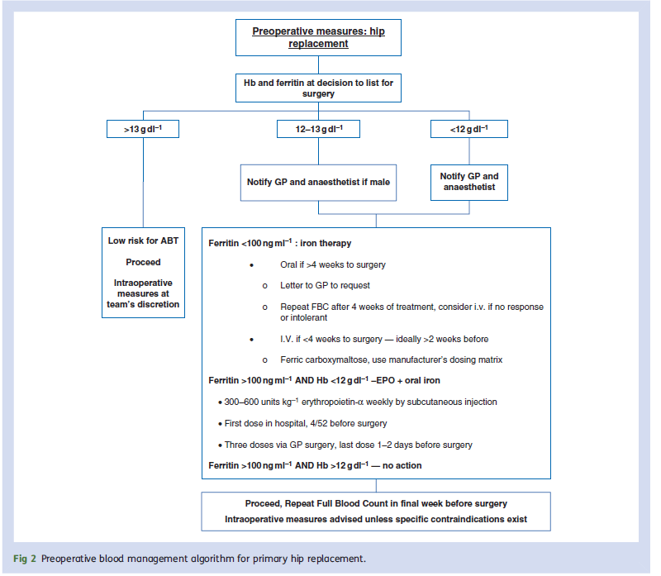

Preoperative measures Hgb patient blood management algorithm

Slide 8
Preoperative Patient Status Assessment
Mobility status (ROM, Leg Length, Pelvic Tilt, Contractures)
HIV, Hepatitis B-C
Blood Management strategy (preoperative Hgb)
Existing Microbial Load (Teeth abscess, Urinary tract infection ,skin lesions, MRSA in nasal cavity)
Skin condition (previous operation, Psoriasis)

Slide 9
Preoperative Patient Status Assessment
Anesthesiologist and cardiologist evaluation
Lab Workout (ECG, HBC, GLU,BUN, CRE, Blood Type and Rhesus, Chest X-ray, ABT units)
Physiotherapy and practice before the operation?
Same day admission
Preoperative shower?
Shaving or Trimming

Slide 10
Preoperative Education for Total Hip and Knee Replacement Patients Lawren H. Daltroy, Catherine I. Morlino, Holley M. Eaton, Robert Poss, and Matthew H. Liang Arthritis Care and Research
The educational intervention reduced length of stay
and pain medication use for patients who exhibited most denial
(tendency to avoid thinking about unpleasant events),
and reduced postoperative anxiety and cognitive errors
on the Mini-Mental State Exam for patients with most baseline anxiety.
There was no effect on postoperative pain.

Slide 11
Red Flags
Renal Insufficiency- Failure
Cardiac Ischemia- Failure
Pulmonary disease
Anticoagulants
Aspirin?
Allergy in Metals (Ni, Cr, Ti, Co)
Allergy in medication
Fever or active disease

Slide 12
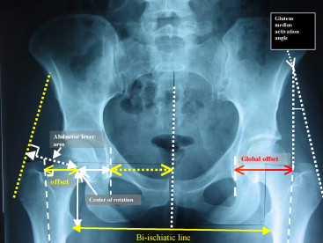
Preoperative Planing
Manual or Computer Templating
Consider Leg Length
Center of Rotation
Optimizing Offset
Position of Acetabulum and Inclination
Position of Calcar osteotomy
Size of Implants and material
Fixation of implants (cement, screws, HA)

Slide 13

Templating hip arthroplasty

Slide 14
Preoperative Planing
Autologous blood donation?
Cell saver
Approach and positioning of the patient
C-arm?
Traction table?
Implant selection

Slide 15
Intraoperative Patient handling
Correct side marking on skin
Antibiotics during induction phase
General or combined anesthesia
Nerve blocks
Foley catheter?
Infiltration with local anesthetic solution

Slide 16
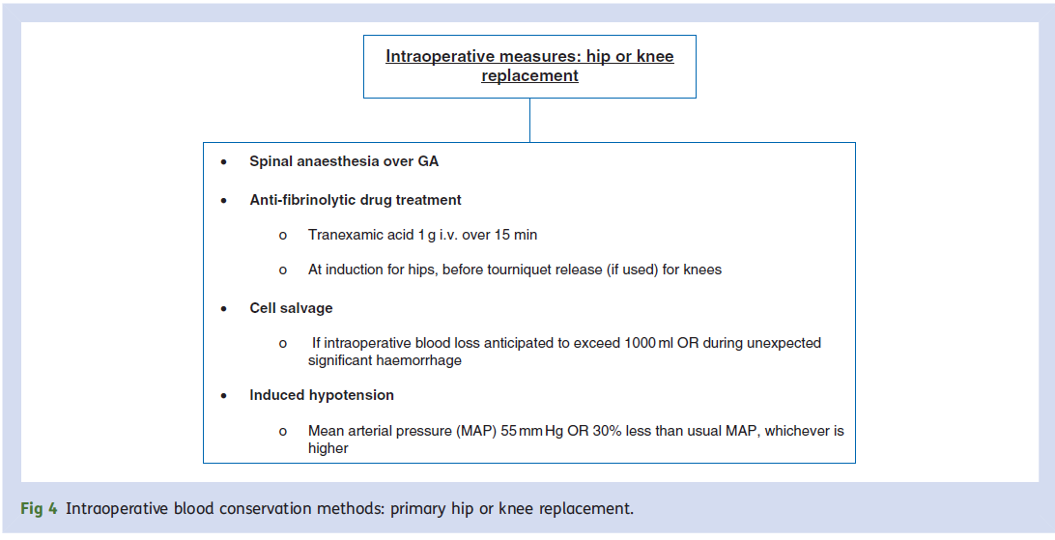
Intraoperative measures for blood control

Slide 17
Intraoperative Patient handling
Compression stockings or intermittent compression system
Blood salvage system or retransfusion system
Meticulous hemostasis
Use of Tranexamic Acid
Use of postoperative Drain?
Elimination of dead space- respect soft tissue

Slide 18
Systematic review and meta-analysis of the use of tranexamic acid in total hip replacement M. Sukeik, S. Alshryda, F. S. Haddad, J. M. Mason From University College London Hospital, London,United Kingdom J Bone Joint Surg [Br] 2011;93
TXA led to a significant reduction in the proportion of patients requiring allogeneic blood transfusion (risk difference -0.20, 95% CI -0.29 to -0.11, p < 0.00001, I2 15%).
There were no significant differences in deep-vein thrombosis, pulmonary embolism, infection rates or other complications among the study groups.

Slide 19
Intraoperative Patient handling
Avoid patient Hypothermia
Avoid patient Hypoxia
Use laminar Flow and surgical Helmets
Use Steridrape and single use drapes
Change gloves regularly
Respect OR rules (min circulation, sterile corridors, mask and head cover, doors closed)

Slide 20
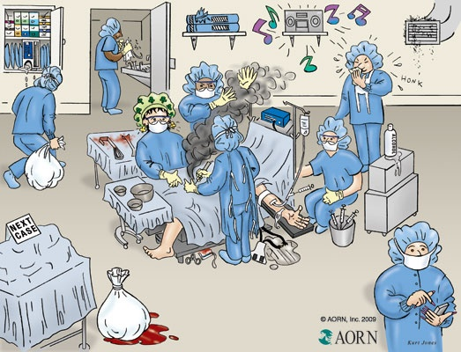

Slide 21
Local infiltration analgesia: a technique for the control of acute postoperative pain following knee and hip surgery A case study of 325 patients Dennis R Kerr and Lawrence Kohan Joint Orthopaedic Centre, Bondi Junction, New South Wales, Australia Acta Orthopaedica 2008
It is based on systematic infiltration of a mixture of ropivacaine, ketorolac, and adrenaline into the tissues around the surgical field to achieve satisfactory pain control with little physiological disturbance.
The technique allows virtually immediate mobilization and earlier discharge from hospital.
LIA is an effective alternative technique.
In our patients, satisfactory mobilization was achieved within 5–6 h and discharge directly home after a single overnight stay was the norm. Longer stays were required if patients had significant comorbidities or inadequate support at home.

Slide 22
Intraoperative Patient handling
Transfer from operating table with caution
Use approach specific cautions while in bed
Keep patient warm and painfree
Antibiotics according to guidelines
LMWH 6-8 h postop

Slide 23
Postoperative Care
Mobilize patient same day or the next morning
Change dressing
Remove drain and Foley catheter
Start Physiotherapy
Monitor HBC and if <8 consider transfusion
Stop iv fluids and decrease narcotics
X-ray Face and Profile

Slide 24
Postoperative Care
Use LMWH or antiX-factor drugs for 4-6 weeks
Use walker or crutches
Use anti-embolism compression stockings
Instruct patient what to avoid and how to mobilize in and out of bed
Use toilet seat augment?

Slide 25
Μultiple factors contribute to postoperative morbidity, length of stay in hospital, and convalescence
Surgery
Pain Fatigue
Stress response/organ dysfunction
Nausea, vomiting, ileus
Hypoxaemia, sleep disturbances
Immobilisation, semistarvation
Drains/nasogastric tubes, restrictions
Delayed recovery

Slide 26
Discharge permitting conditions
Hemodynamically stable patient
Pain control without narcotics
Able to mobilize freely out of bed
Able to use the toilet
Able to walk unassisted for 100 steps
Able to ascend and descend some stairs
Facilities at home can accommodate safely the patient
Otherwise send to recovery center

Slide 27
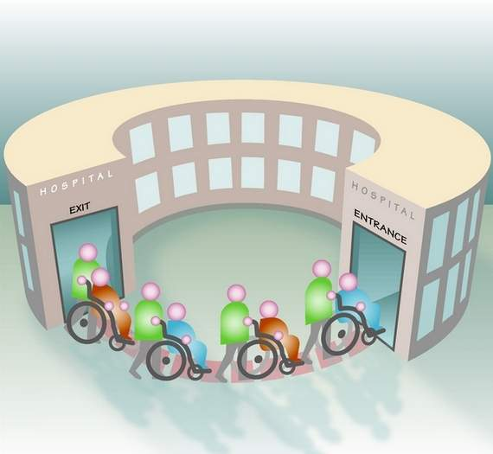

Slide 28
Red flags
Low blood pressure ,low HBC
Poor renal function
Non urinating properly (men)
Fever
Wound discharge or poor healing
Delirium or poor understanding of instructions

Slide 29
Follow-up visit
15days for suture removal
1 month for X-ray and control of walking progress
3 or 6 months for X-ray
Every year for X-ray and monitoring of implant loosening

Slide 30
Red Flags
History of fall
Trendelenburg sign that persists or appears
Leg length difference >1cm
Persistent pain
Fever or erythema of the wound
Leg swelling
Breathing difficulties

Slide 31
Conclusion
Total Hip Arthroplasty is a safe and effective operation to restore mobility and to decrease joint pain.
Complications can be low provided we anticipate and know the limitations of the procedure and each patient
Respect the Guidelines and Indications
Deal with the problems as soon as they appear

Slide 32
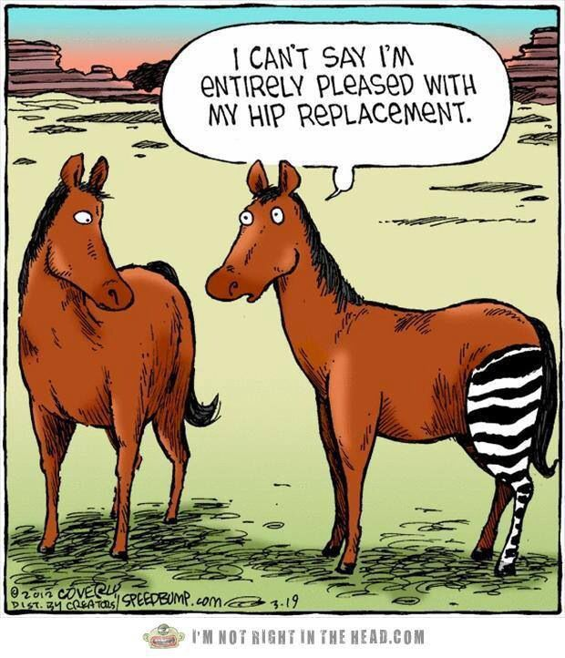

Slide 33
Take Home Message
Know your patient
Follow the indications
Template your operation
Respect the Guidelines
Encourage early mobilization
Address all complications in good time

Slide 34
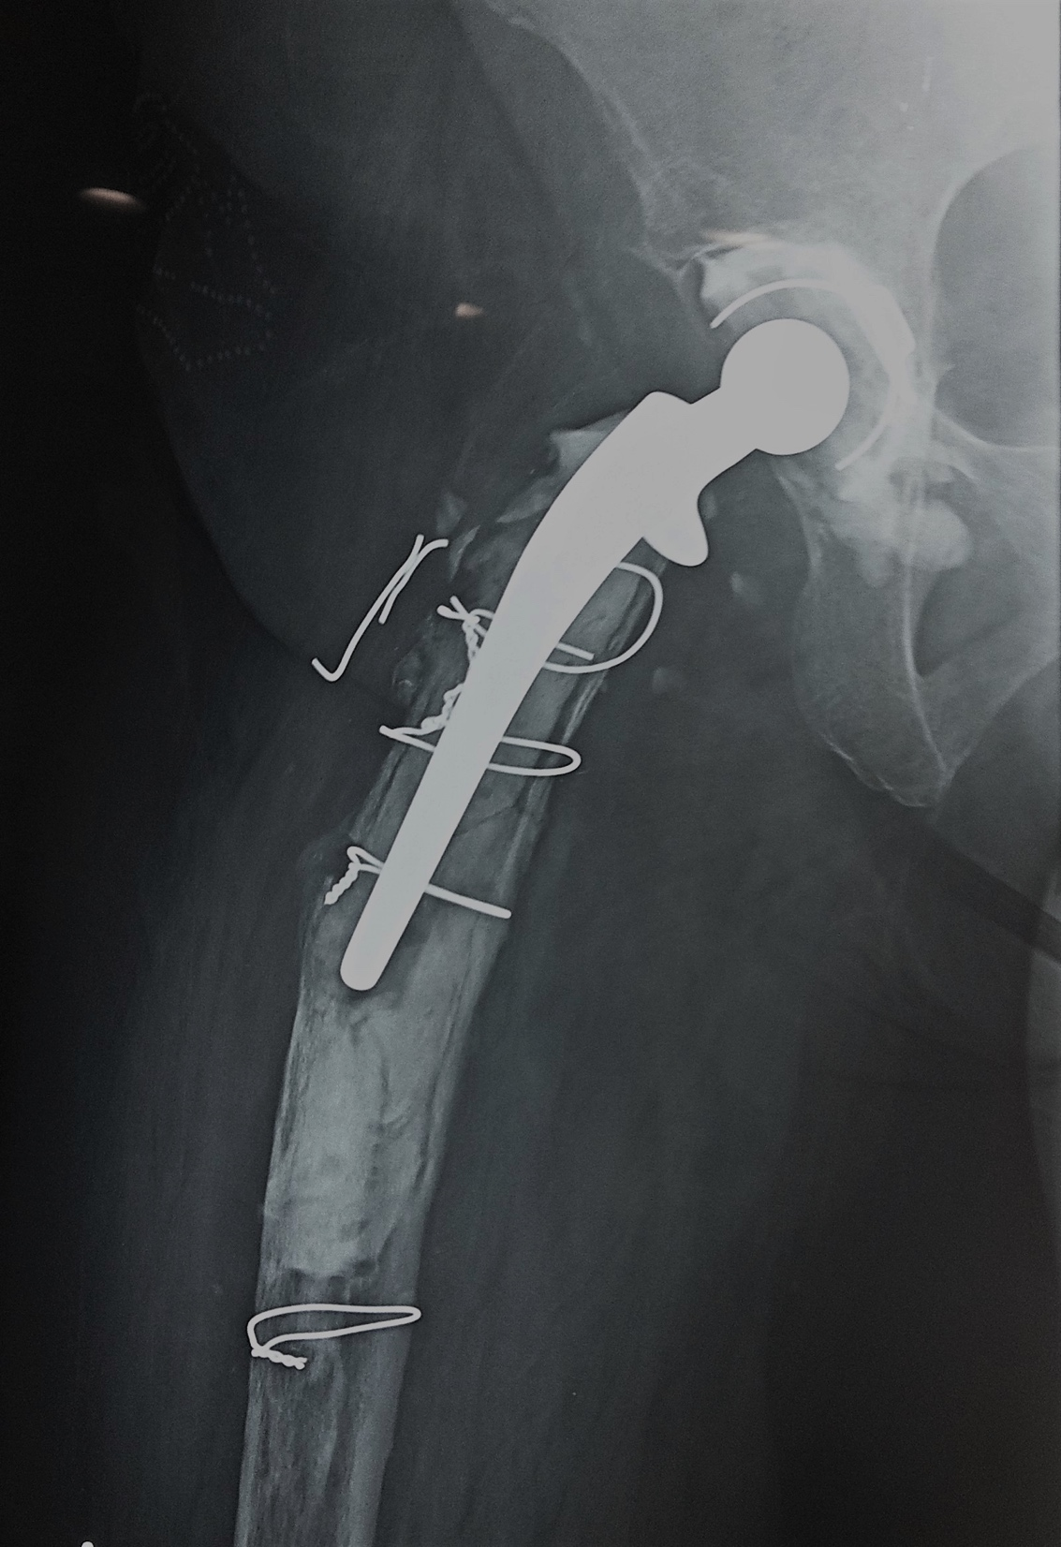
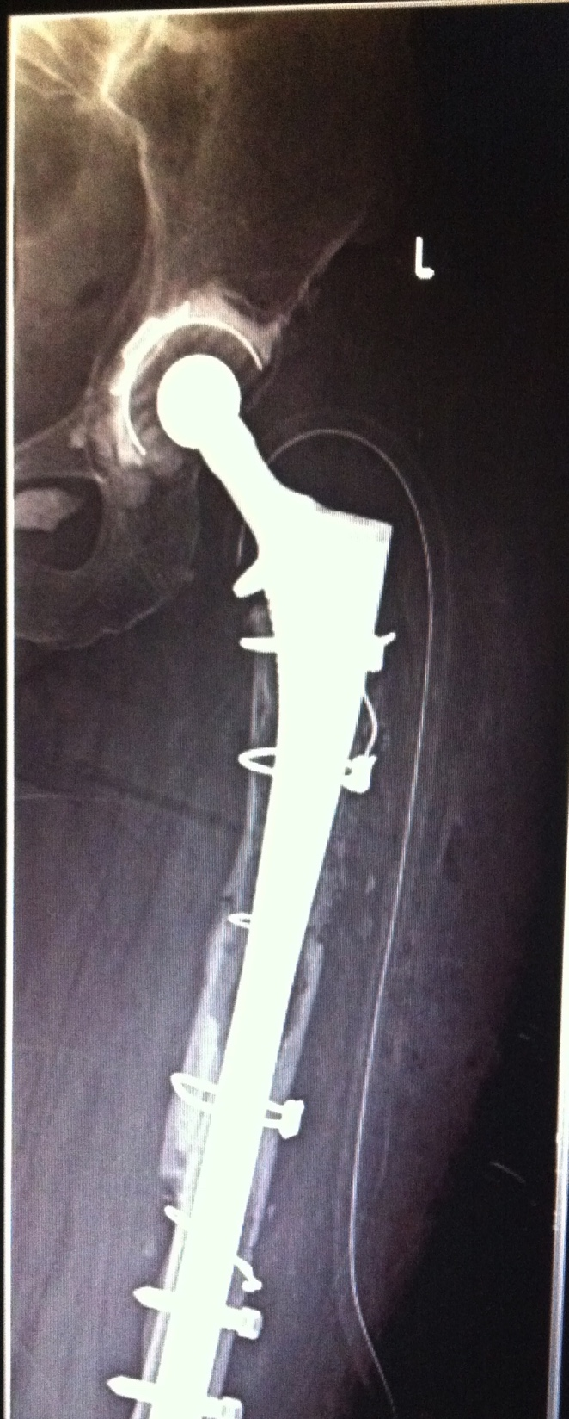
Thank you
THR is not the end of the journey!
It's the beginning .

