Slide 1


TOTAL HIP REPLACEMENT ARTHROPLASTY
GEORGE D. KYRITSIS
Orthopaedic Surgeon
Metropolitan Hospital

Slide 2
TOTAL HIP REPLACEMENT ARTHROPLASTY
No pain. No discomfort
Quick and excellent results
Aesthetic scar
No reoperation No Revision
Less expenses
The Patient
EXPECTATIONS
Less technical demands
Repeating, excellent results
Quality and cost effective THR material
No reoperation No Revision
Satisfied patient
The Surgeon

Slide 3
FACTORS AFFECTING THE FINAL RESULT
OF A THR ARTHROPLASTY
The patient
The surgical technique
The kind of the materials
The operating theatre

Slide 4
PLANNING A THR ARTHROPLASTY
Kind of arthroplasty (THR, SURFACE)
Surgical approach (MIS, STANDARD)
Special characteristics of materials
Stabilization of material (Cement, Press fit)
Existing additional aid (Navigation, Robot)
Post-op care of patient

Slide 5
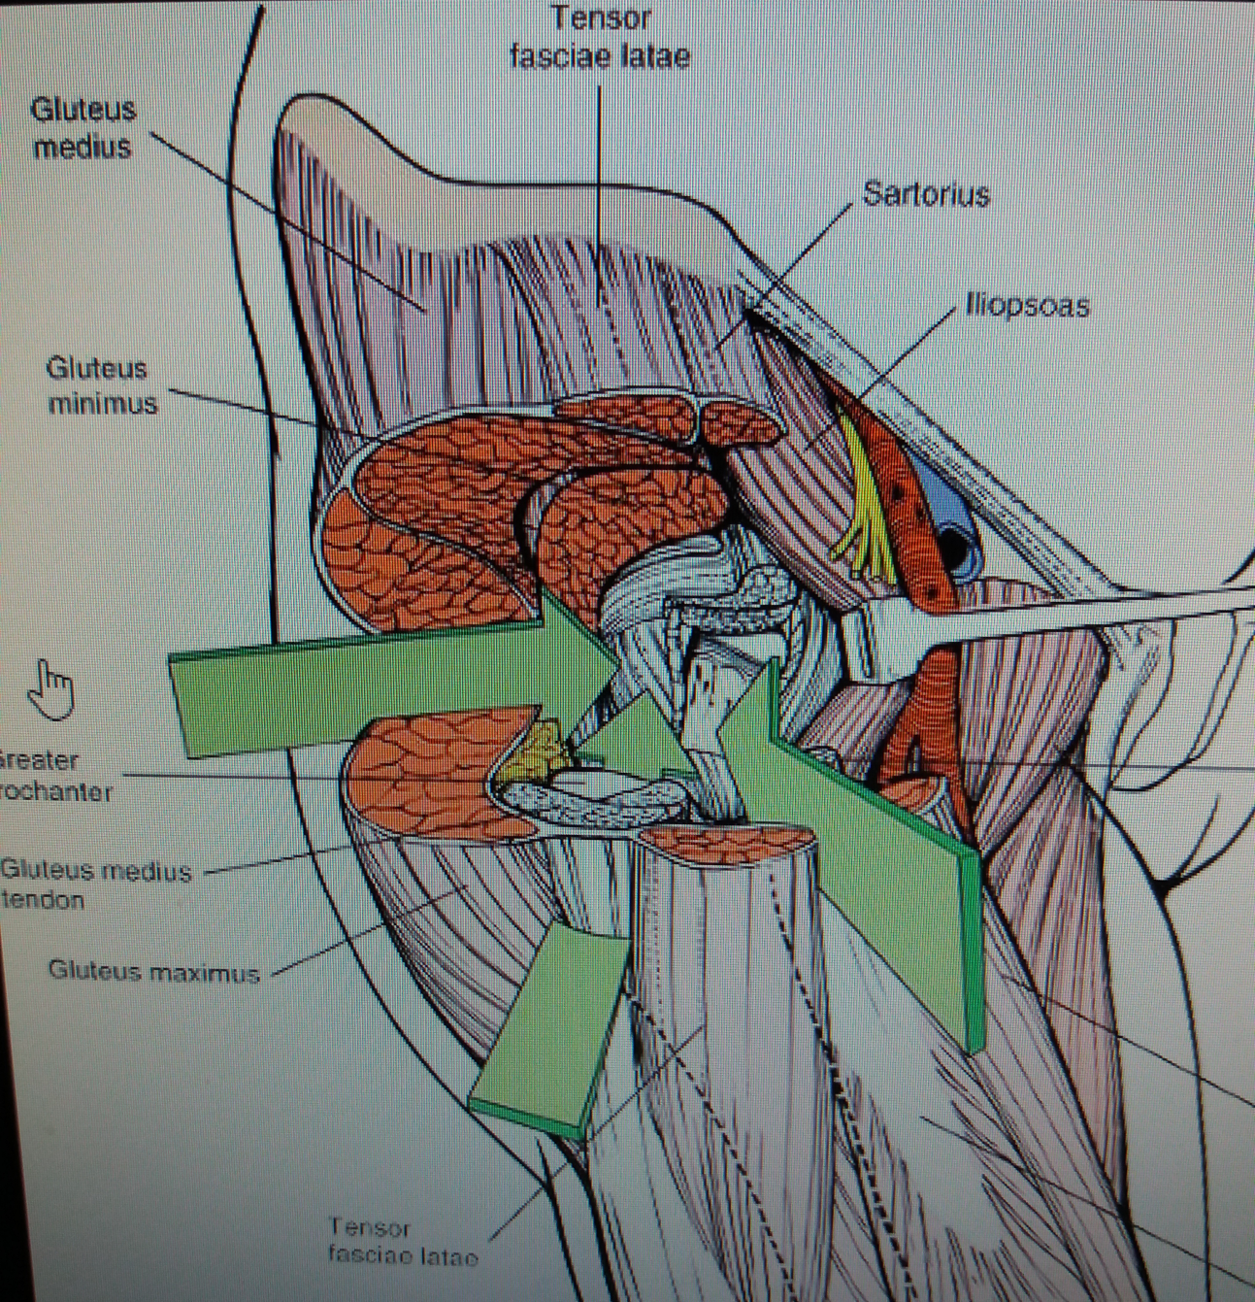
THE “CLASSIC” APPROACHES
OF THR ARTHROPLASTY
ANTERIOR (SMITH – PETERSEN)
ANTEROLATERAL (WATSON – JONES)
LATERAL and TRANSTROCHANTERIC (HARDINGE)
POSTEROLATERAL (AUSTIN – MOORE)

Slide 6
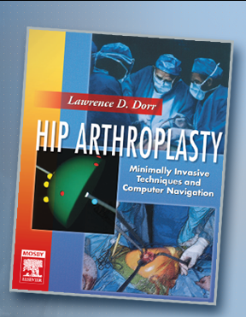
“The hip surgeon should be familiar with all major approaches to the hip and should have an excellent perception of the three dimensional anatomy in the coronal, sagitalar axial planes. Extensive exposure in required for total hip and especially the surface replacement arthroplasty”.
-----------
“The incision selected should allow extension to the iliac crest and the distal femur, if needed.
This point is especially important for
revision surgery and for cases with
unusual anatomic deformities,
such as congenital dysplasia d the hip”.
LAURENCE DORA (Minimally Invasive Techniques and
Computer Navigation)

Slide 7
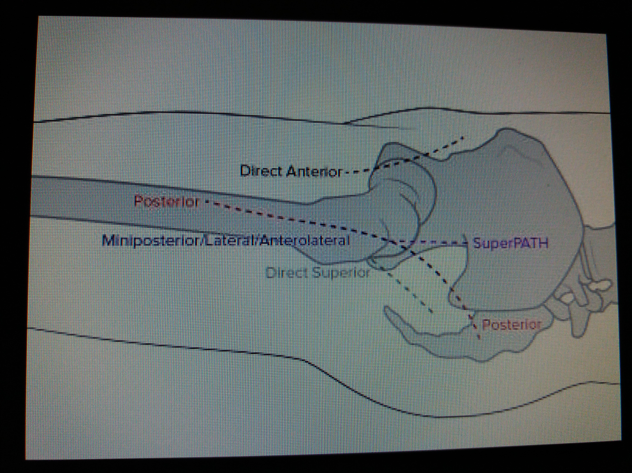
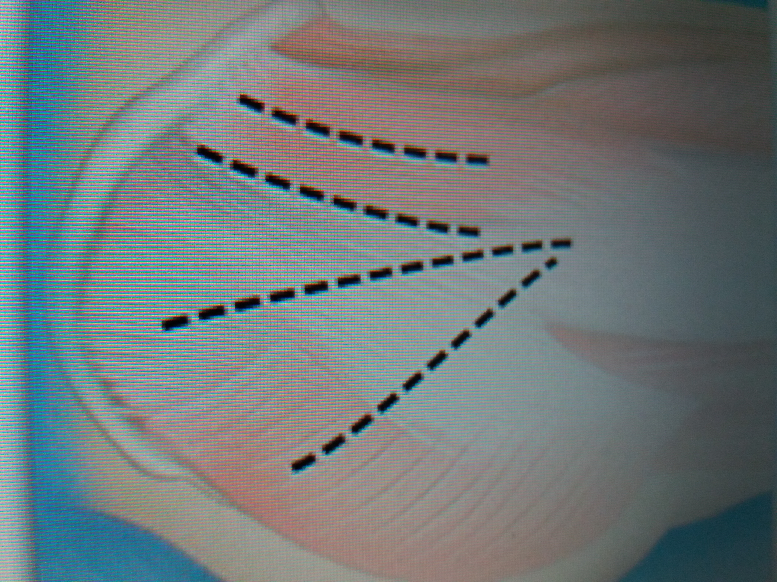
“The best approach is the approach
you know better to perform”.

Slide 8
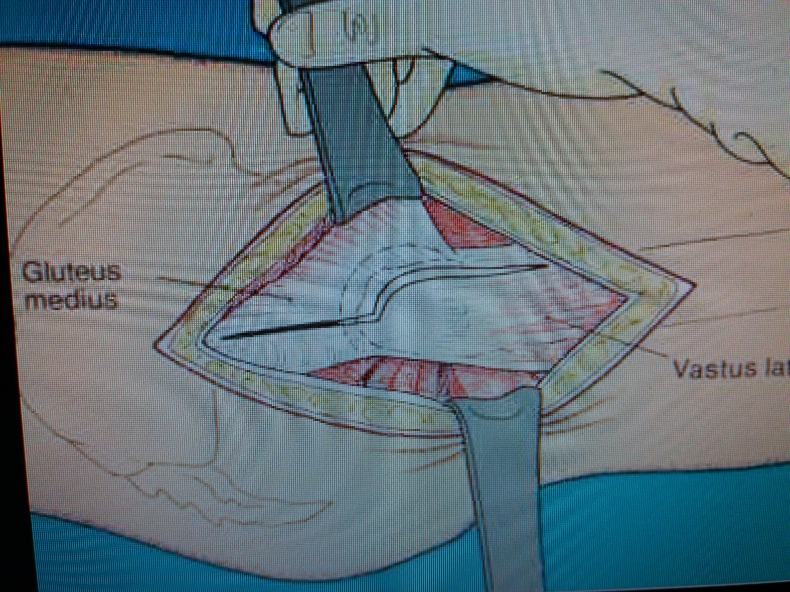
THE LATERAL APPROACH (HARDINGE)
Patient on the side
True lateral approach. Skin incision ∼ 10-12 cm
Incision of tensor fasciae latae
Partial detachment of gluteus medius from the major trochanter
Capsulotomy with
anterior dislocation
of the femoral head
Reattachment of
gluteus medius to
the major trochanter
with strong sutures

Slide 9
By this approach I can perform
THR arthroplasty
THR arthroplasty for dysplasia
Surface arthroplasty (Double-cup)
Robot assisted THR arthroplasties
Revision THR arthroplasty
Periprosthetic fractures with Revision of the existing arthroplasty
Oncologic operations with replacement of the proximal femur with a THR arthroplasty

Slide 10
ADVANTAGES
Can proceed to any THR arthroplasty
Can sufficient extend the incision
Can fully check the acetabulum and perform a cotyloplasty
Can revise an existing arthroplasty through the same approach
Can use Navigation and Robot

Slide 11
DISADVANTAGES
Give longer scars
Result in dysfunction of the abductors of the hip, temporarily, postoperatively
More blood loss
Longer hospitalization (4-6 d)
Higher disarticulation rate (1-2%)
Slower rehabilitation
Slower return back to work (2-3 months) and other activities

Slide 12

“The benefits to the patient of an anatomic and structurally sound reconstruction far outweigh any cosmetic deficits caused by a slightly longer incision”.
Henri Judet:
“Mini – Invasive Surgery of the Hip”

Slide 13
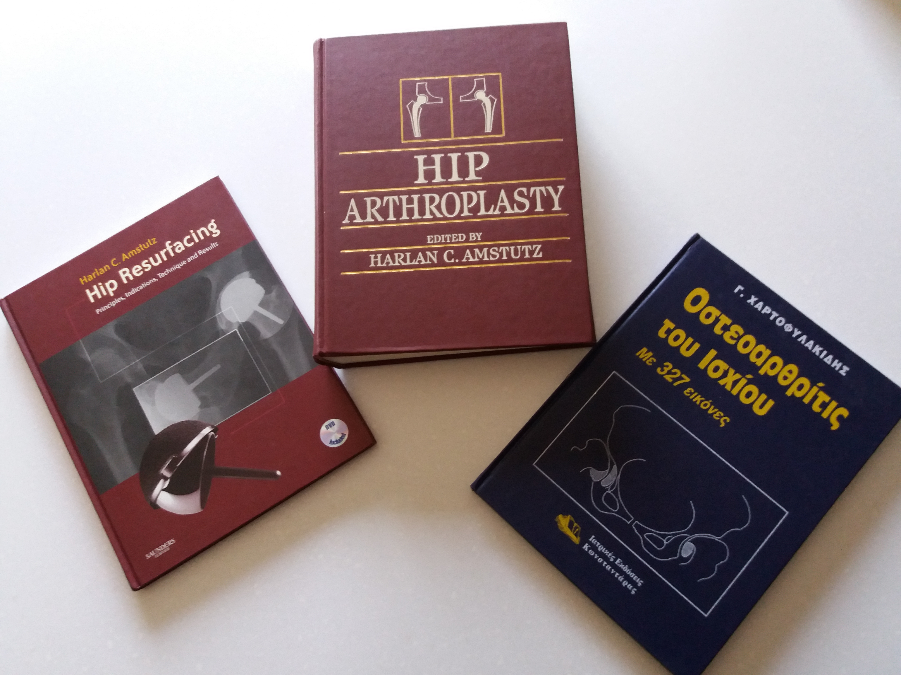
Eυχαριστώ

